Slide 1
IMPLEMENTATION OF MINIMUM SPANNING TREE (MST) USING ON KRUSKAL’S AND PRIM’S ALGORITHM
CSE225
Spring 2020

Slide 2
How does Prim’s Algorithm Work ?
The idea behind Prim’s algorithm is simple, a spanning tree means all vertices must be connected.
So the two disjoint subsets (discussed above) of vertices must be connected to make a Spanning Tree. And they must be connected with the minimum weight edge to make it a Minimum Spanning Tree.

Slide 3
BACKGROUND INFORMATION
We have discussed Kruskal’s algorithm for Minimum Spanning Tree. Like Kruskal’s algorithm, Prim’s algorithm is also a Greedy algorithm.
It starts with an empty spanning tree. The idea is to maintain two sets of vertices.

Slide 4
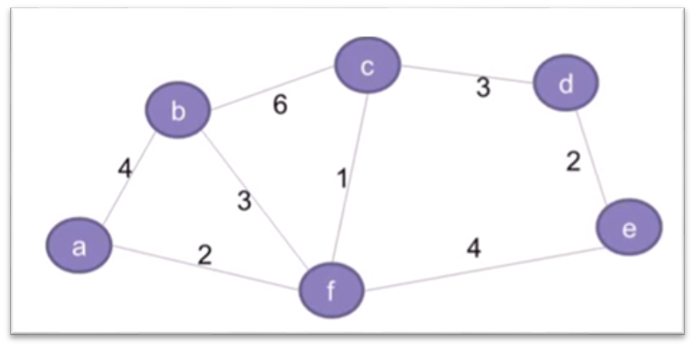
WORKABLE SOLUTIONS
Suppose we have to connect offices of a telecommunication organization across the multiple location we have to use minimum spanning tree. Telecommunications organization, has offices spanned across multiple locations around the globe. It has to use leased phone lines for connecting all these offices with each other. The cost(in units) of connecting each pair of offices is different and is shown here :

Slide 5
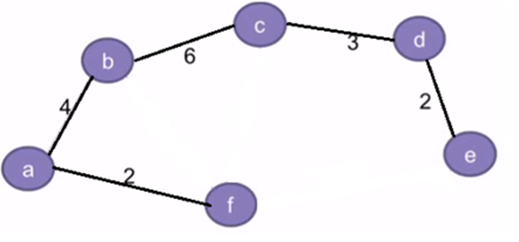
WORKABLE SOLUTIONS
The concepts related to Prim's Algorithm which is used for finding the minimum spanning tree for a given graph are given here :

Slide 6
Algorithm for Prim's Minimum Spanning Tree
Step 1: Keep a track of all the vertices that have been visited and added to the spanning tree.
Step 2: Initially the spanning tree is empty.
Step 3: Choose a random vertex, and add it to the spanning tree. This becomes the root node.
Step 4: Add a new vertex, say x, such that
x is not in the already built spanning tree.
x is connected to the built spanning tree using minimum weight edge. (Thus, x can be adjacent to any of the nodes that have already been added in the spanning tree).
Adding x to the spanning tree should not form cycles.
Step 5: Repeat the Step 4, till all the vertices of the graph are added to the spanning tree.
Step 6: Print the total cost of the spanning tree.

Slide 7
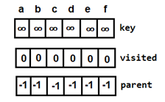
TO CONNECT THE OFFICES HOW THIS ALGORITHM SHOULD APPLY:
Step A:
Define key[], booleanvisited[] and parent[] arrays first of all. Here, key[] for storing the key values, booleanvisisted[] for keeping a track of all vertices, parent[] for keeping the track of parent vertices. Initialize minimum cost,
minCost = 0

Slide 8




Step B:
Choose any random vertex, say
f and set key[f]=0.
• minCost = 0 + key[f] = 0

Slide 9
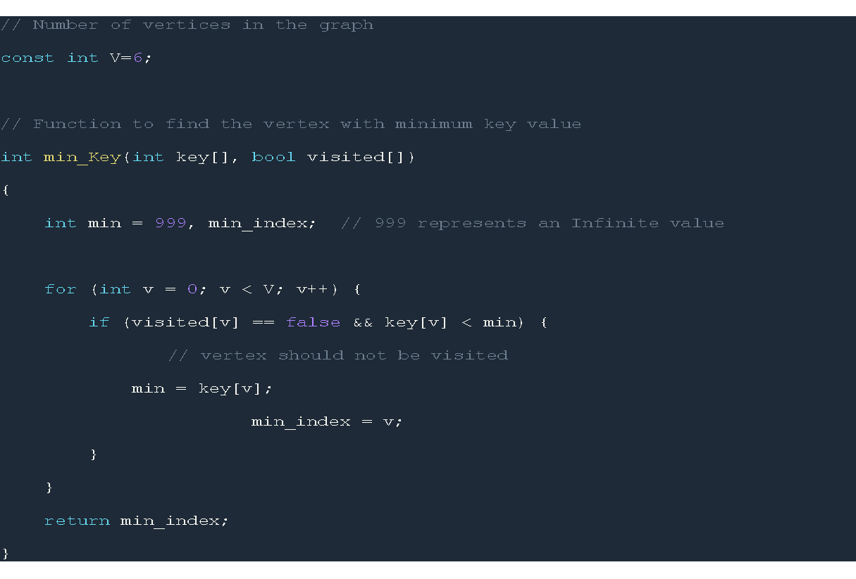
Here , we can see min_key() function that work if the vertex visited or not.

Slide 10



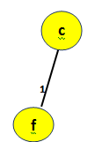
Step C:
The arrays key[] and visited[] will be searched for finding the next vertex.f has the minimum key value but will not be considered since it is already added (visited[f]==1).Next vertex having the minimum key value is c. Since visited[c]==0, it will be added to the spanning tree.
minCost = 0 + key[c] = 0 + 1

Slide 11
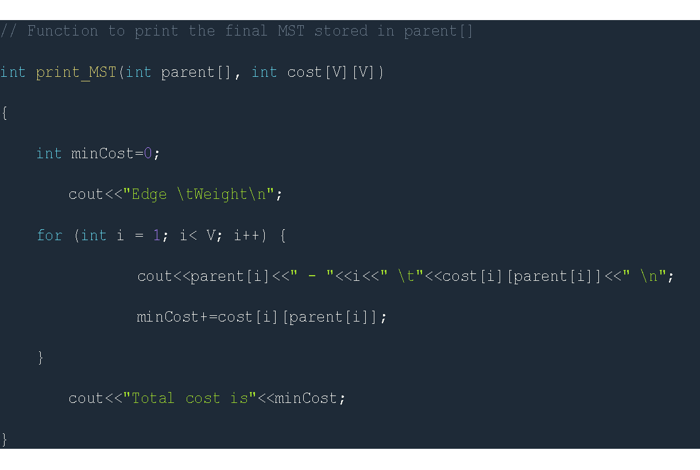
This is how the visited[] array will look like.And, the parent[] array (f becomes the parent of c):And, the parent[] array (f becomes the parent of c).For every adjacent vertex of c, say v, values in key[v] will be updated using the formula:
key[v] = min(key[v], cost[c][v])

Slide 12
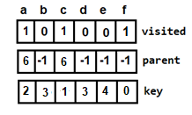
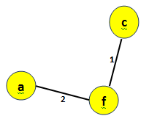
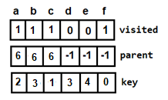
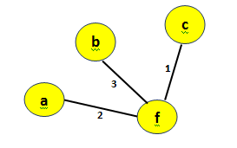
Step D:
Next vertex to be selected is a.
minCost=1+2=3
Next vertex to be selected is b.
minCost=3+3=6

Slide 13
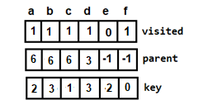
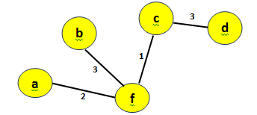
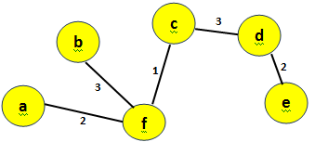
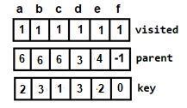
Next vertex to be selected is d.
minCost=6+3=9
Next vertex to be selected is e.
minCost=9+2=11

Slide 14
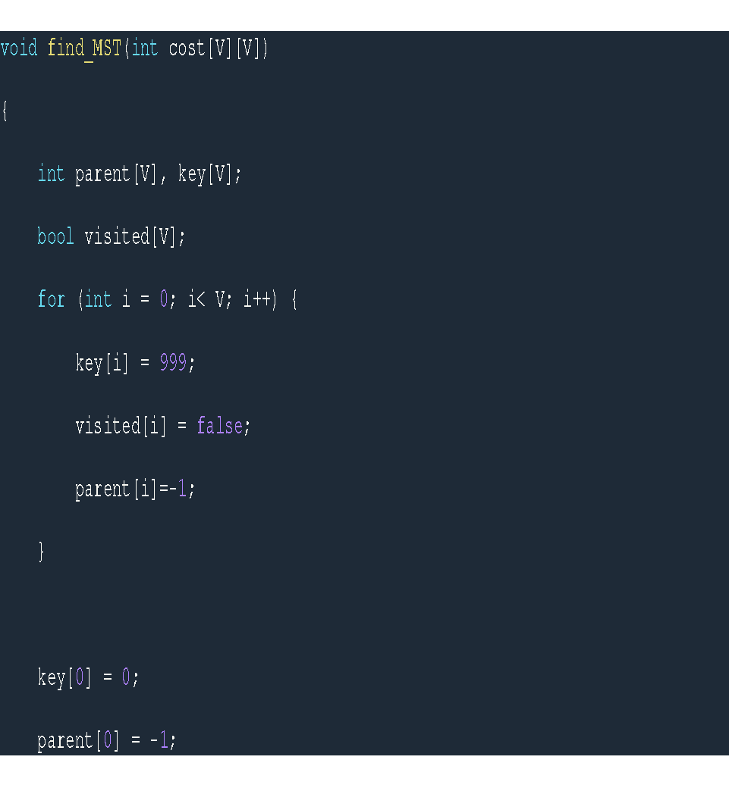
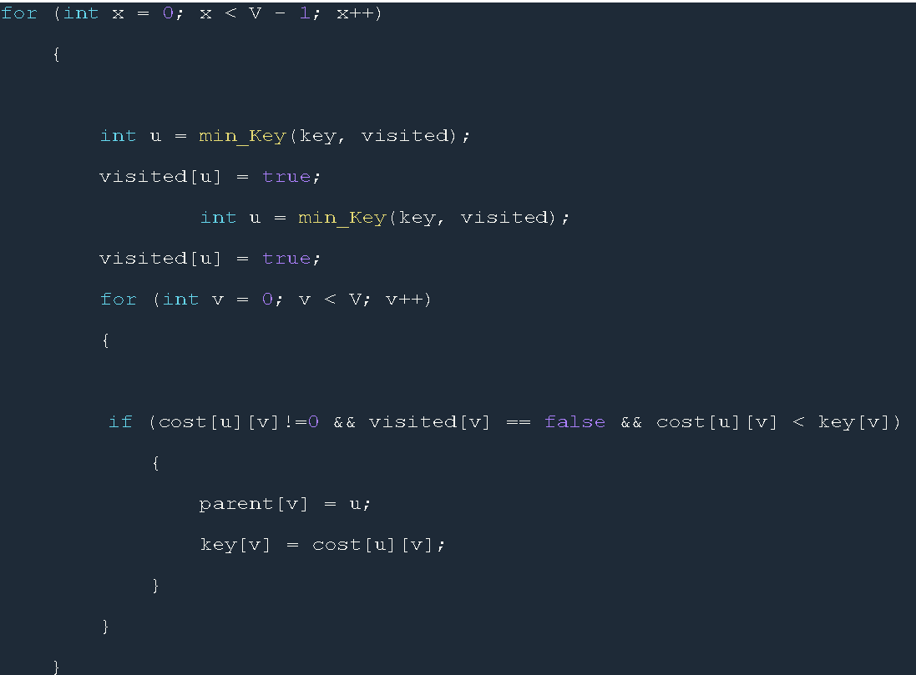
SINCE ALL THE VERTICES HAVE BEEN VISITED NOW, THE ALGORITHM TERMINATES. THUS, THE MINIMUM SPANNING TREE WITH TOTAL COST=11.

Slide 15
In the code we found the total cost of spanning tree. The organization, thus, wants to use minimum cost for connecting all its offices. This requires that all the offices should be connected using minimum number of leased lines so as to reduce the effective cost. By Implementing of Prim's Minimum Spanning Tree Algorithm we can connect the offices with easier way.

Slide 16
KRUSKAL ALGORITHM FOR MST
GIVEN A CONNECTED AND UNDIRECTED GRAPH, A SPANNING TREE OF THAT GRAPH IS A SUBGRAPH THAT IS A TREE AND CONNECTS ALL THE VERTICES TOGETHER. A SINGLE GRAPH CAN HAVE MANY DIFFERENT SPANNING TREES. A MINIMUM SPANNING TREE (MST) OR MINIMUM WEIGHT SPANNING TREE FOR A WEIGHTED, CONNECTED AND UNDIRECTED GRAPH IS A SPANNING TREE WITH WEIGHT LESS THAN OR EQUAL TO THE WEIGHT OF EVERY OTHER SPANNING TREE. THE WEIGHT OF A SPANNING TREE IS THE SUM OF WEIGHTS GIVEN TO EACH EDGE OF THE
SPANNING TREE.

Slide 17
KRUSKAL ALGORITHM APPLICATION
THE BEST USE FOR KRUSKAL ALGORITHM WOULD BE FINDING OUT THE SHORTEST PATH FOR LAYING DOWN TELEPHONE OR CABLE WIRES. IN THIS WAY, THE TELEPHONE OR THE CABLE COMPANY SAVES HUGE AMOUNT ON THE COST OF WIRES AND AT THE SAME TIME, THE REDUNDANCY OF PATH FROM WHICH INFORMATION TRAVELS DECREASES AND HENCE MUCH LESS NOISE.

Slide 18
PRIMS ALGORITHM FOR MST
Prim's (also known as Jarník's) algorithm is a greedy algorithm that finds a minimum spanning tree for a weighted undirected graph. This means it finds a subset of the edges that forms a tree that includes every vertex, where the total weight of all the edges in the tree is minimized. The algorithm operates by building this tree one vertex at a time, from an arbitrary starting vertex, at each step adding the cheapest possible connection from the tree to another vertex.

Slide 19
PRIMS ALGORITHM APPLICATION
Prim’s algorithm calculates a minimum spanning tree. I learned it in grad school and thought I would never need it. It turns out it was the perfect solution for a problem I had in my work in computational military reasoning (that is AI that made tactical combat decisions). It comes in handy when trying to understand the relationship between combat units on a battlefield.

Slide 20
DIFFERENCE BETWEEN KRUSKAL ALGORITHM AND PRIM’S ALGORITHM
Kruskal algorithm:
It start to build the MST from minimum weighted vertex in the graph
Disjoint set is used in Kruskal algorithm
Kruskal algorithm run faster in sparse graphs
Time complexity is O(E log v)
The next edge include may or may not be connected but should not form the cycle
It traverse the edge only once based on cycle it will either reject or accept it
Greedy algorithm

Slide 21
DIFFERENCE BETWEEN KRUSKAL ALGORITHM AND PRIM’S ALGORITHM
Prim’s algorithm
It start to build the MST from any of the node
Adjency matrix ,binary heap or Fibonacci heap is used in prim’s algorithm
Prim’s algorithm run faster in dense graphs
Time complexity is O(Ev log v) with binary heap and O(E+Vlogv) with Fibonacci heap
The next node included must be connected with the node we traverse
It traverse the one node several time in oder to get it minimum distance
Greedy algorithm

Slide 22
KRUSKAL’S ALGORITHM
Sort the graph edges with respect to their weights.
Start adding edges to the minimum spanning tree from the edge with the smallest weight until the edge of the largest weight.
Only add edges which don’t form a cycle—edges which connect only disconnected components.
Or as a simpler explanation,
Step 1 – Remove all loops and parallel edges
Step 2 – Arrange all the edges in ascending order of cost
Step 3 – Add edges with least weight

Slide 23
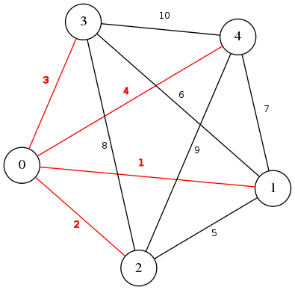
Let Us Implement the Following Graph in QT Using Kruskal’s Algorithm
Number of nodes = 5
Number of edges = 10
Weight of MST = 10

Slide 24
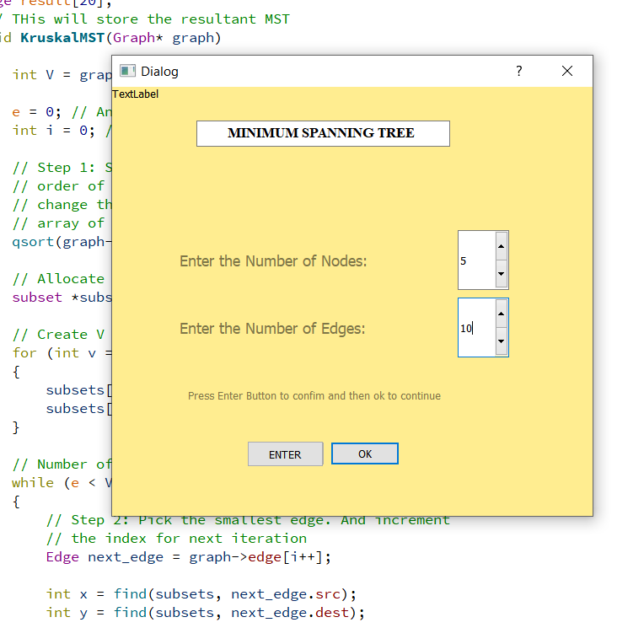
This is the main screen
It takes Nodes and Edges from the user
In the previous graph there were 5 nodes and 10 edges, so we give that input
Next we have to press enter to initiate the graph
Clicking Ok will go to the next pop up window

Slide 25
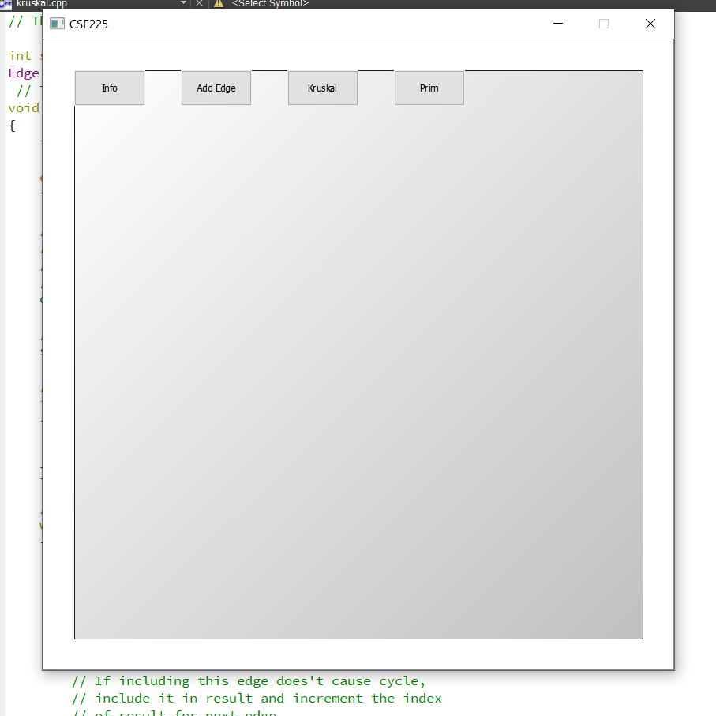
This is our display screen.
There is an info tab that tells the user how to use the program
The Add Edge Button will give another pop-up window.
Pressing Kruskal button will compute the MST using Kruskal’s algorithm

Slide 26
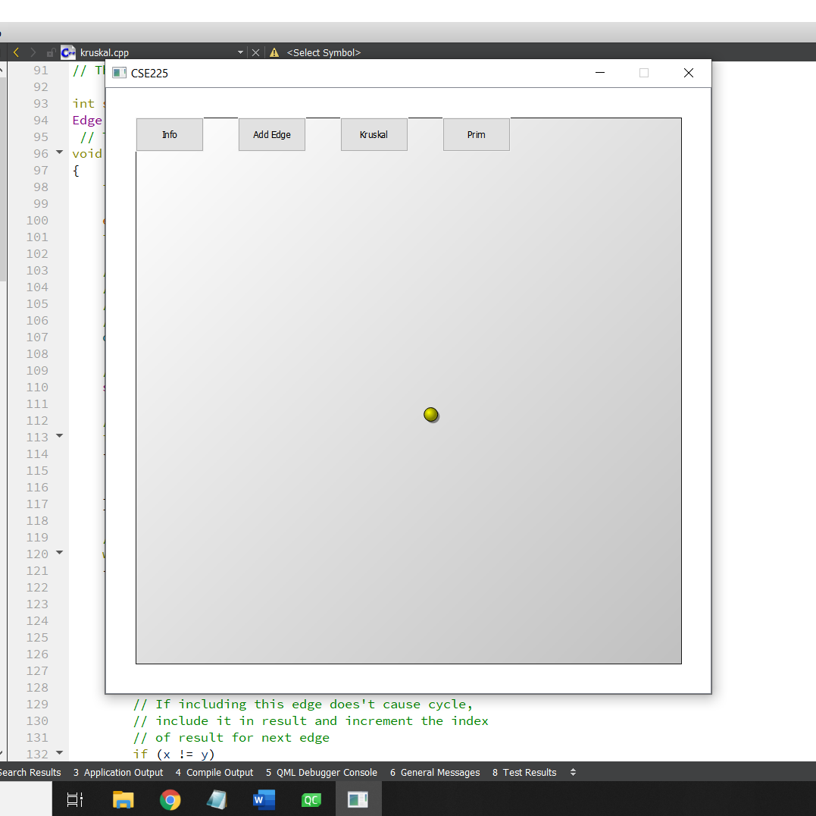
Double clicking the empty space will screen will give us a node

Slide 27
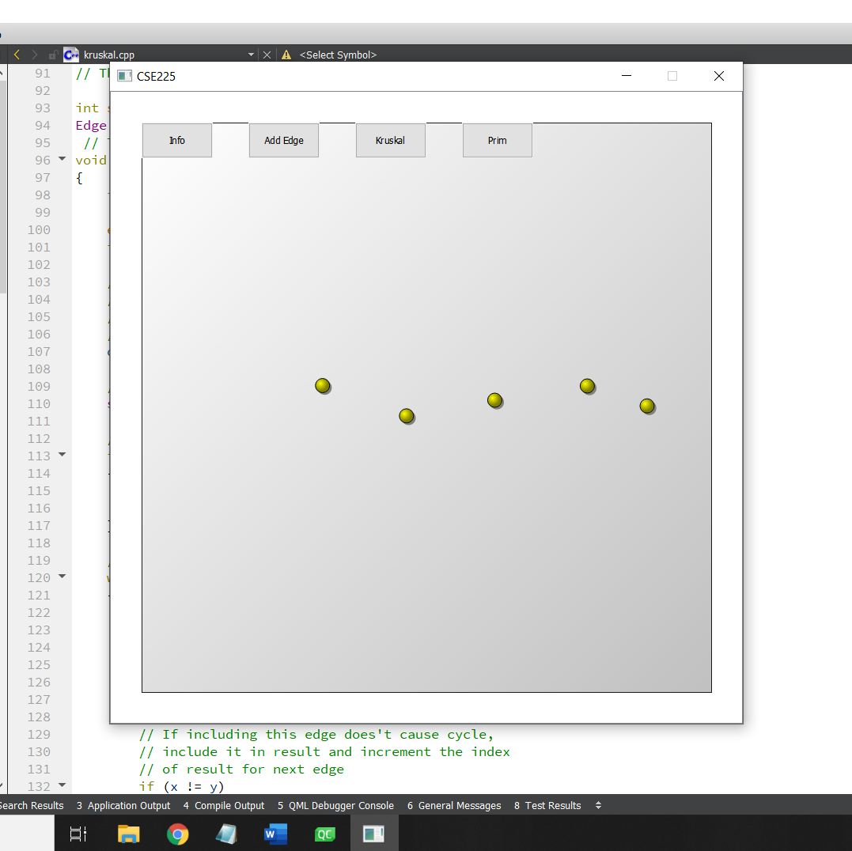
We double clicked 5 times to get 5 nodes

Slide 28

We can move the nodes to our desired position

Slide 29
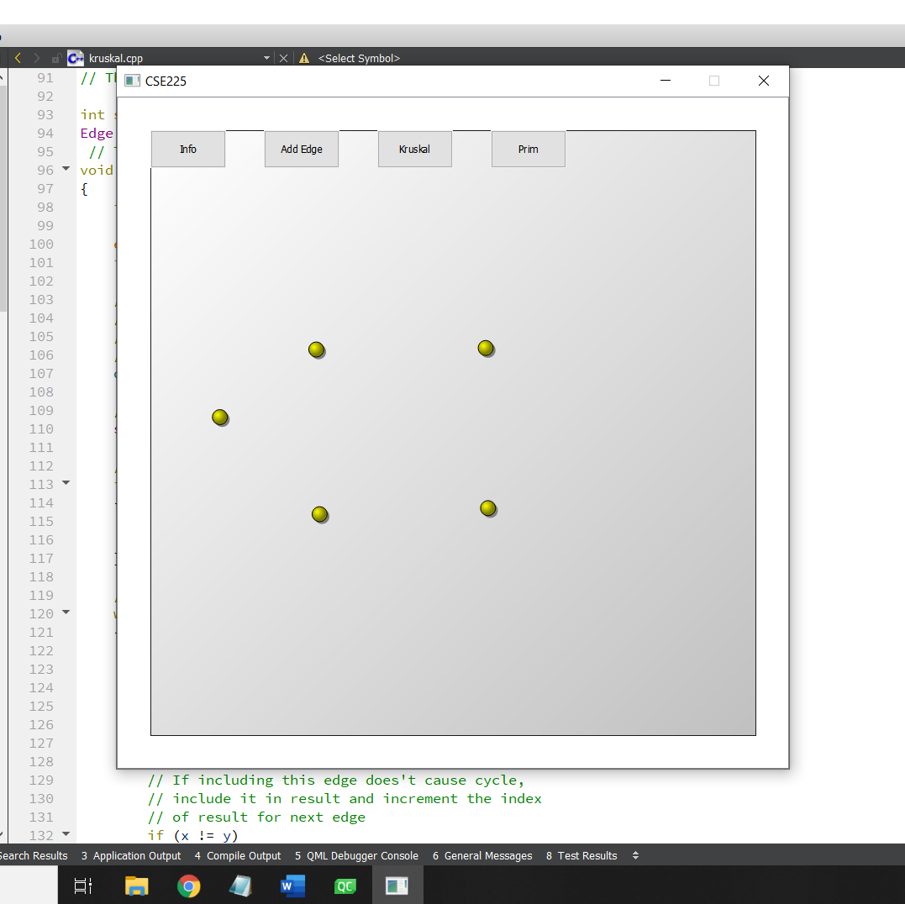
We set the nodes according to the graph we want to implement

Slide 30
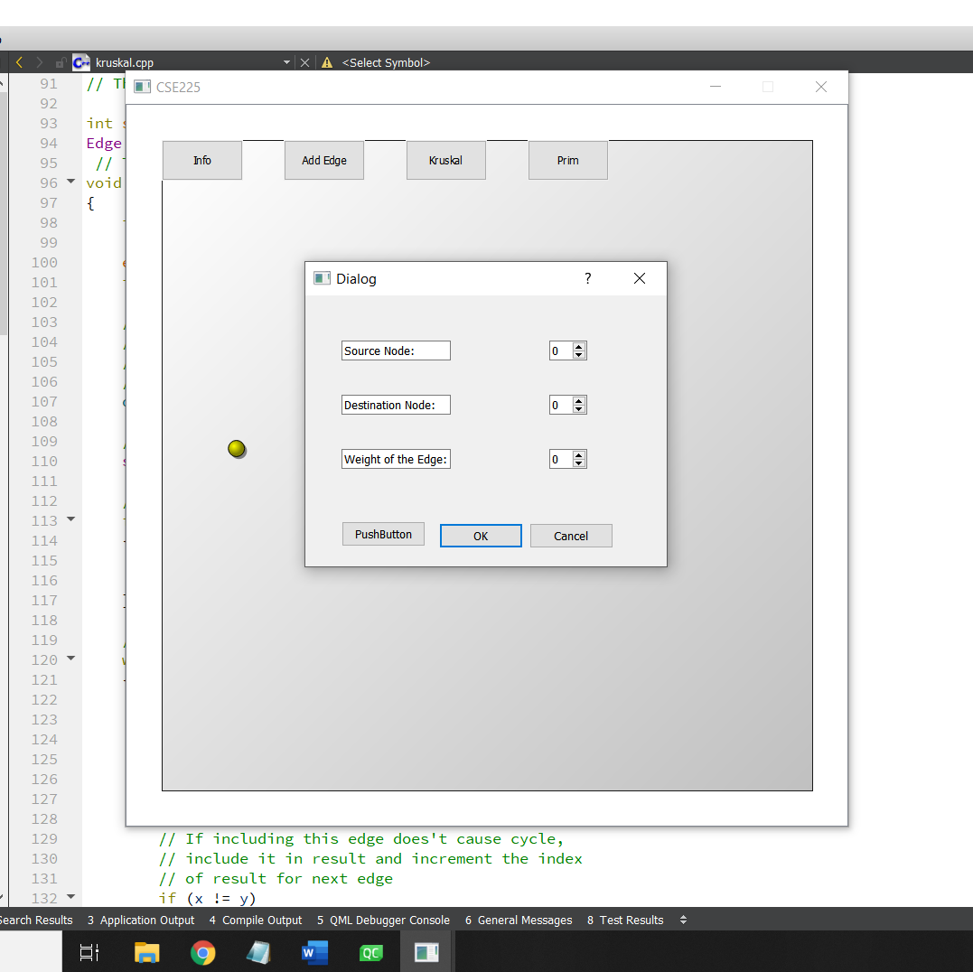
This is the screen we get when we press Add Edge button.
This pop-up will ask the user to the source node, the destination between which the edge is to be created and also the weight of the edge

Slide 31
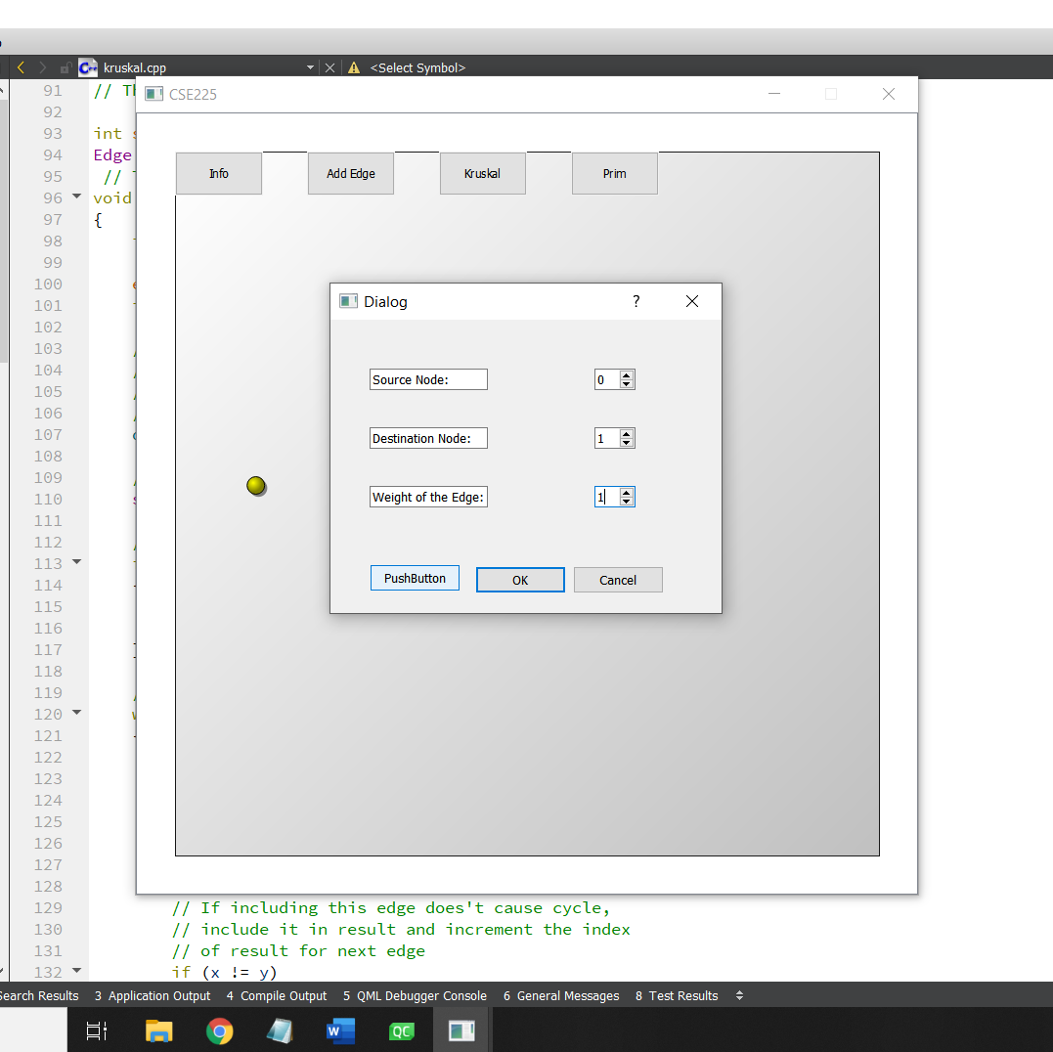
We enter the first edge.
It is between node 0 and node 1, and the weight is also 1
We have to press PushButton to insert the values
Then we click Ok

Slide 32
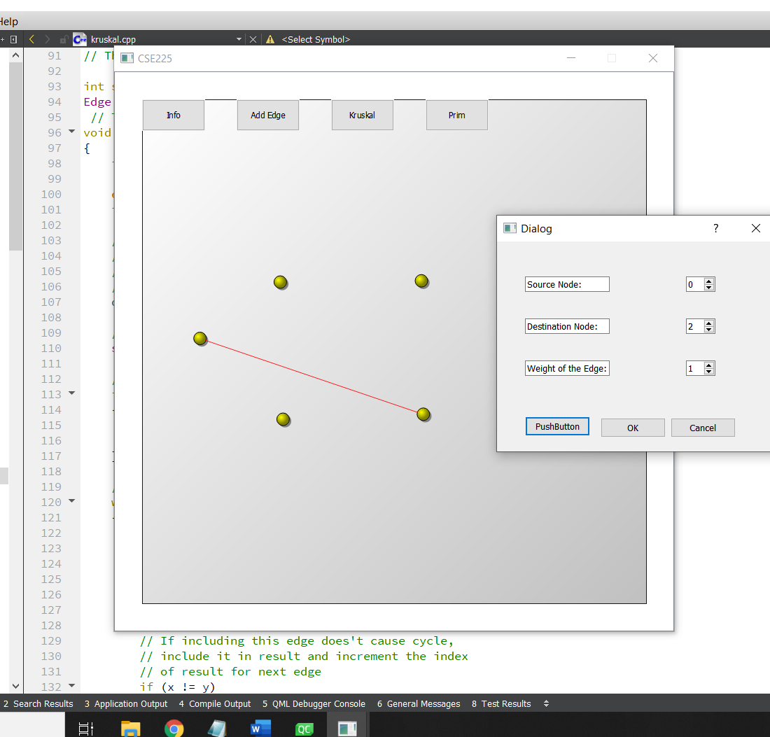
First edge has been inserted between node 0 and node 1.
We again add the next edge of weight 2 between node 0 and 2. Here the screenshot was taken before the weight 2 was inserted.

Slide 33
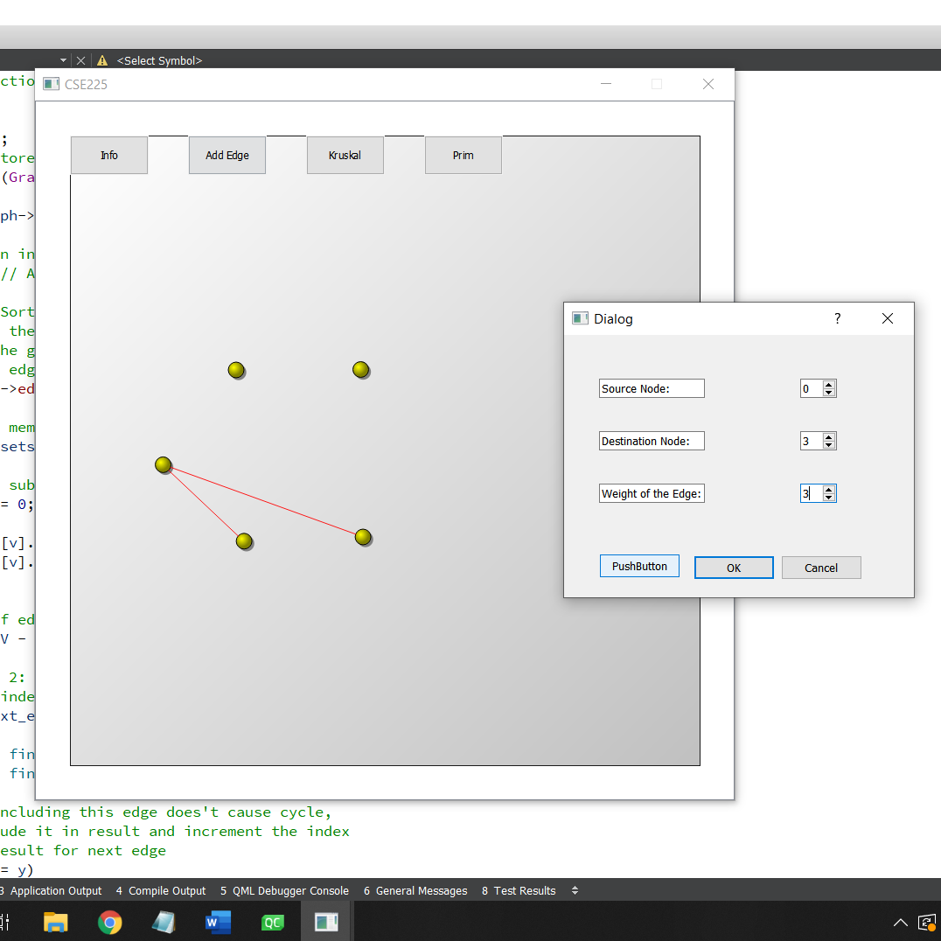
New edge has been added.
We add edge between node 0 and 3, weight = 3

Slide 34
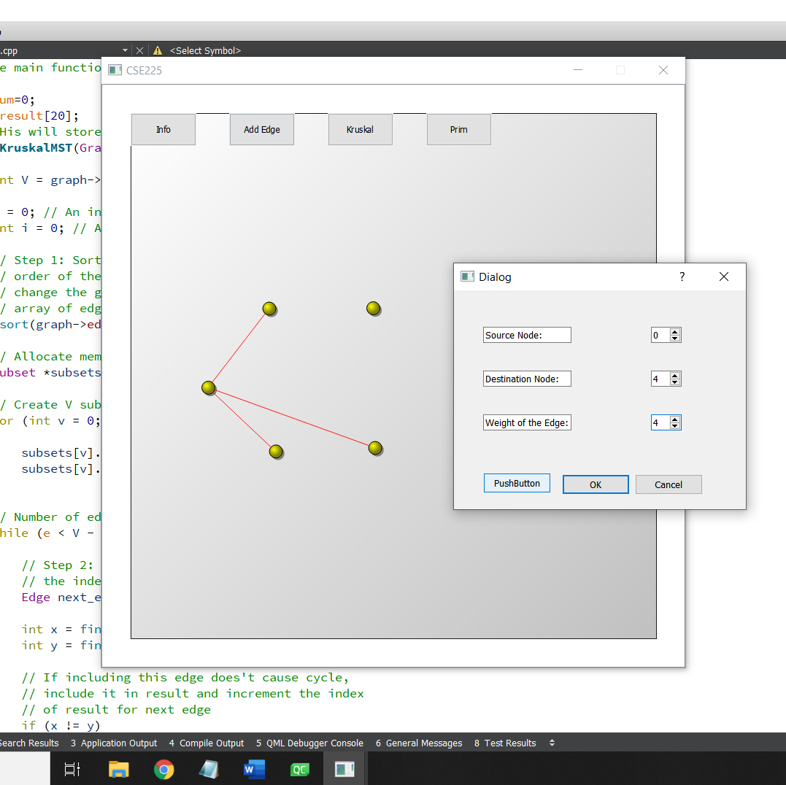
We add edge between 0 and 4 with weight 4

Slide 35
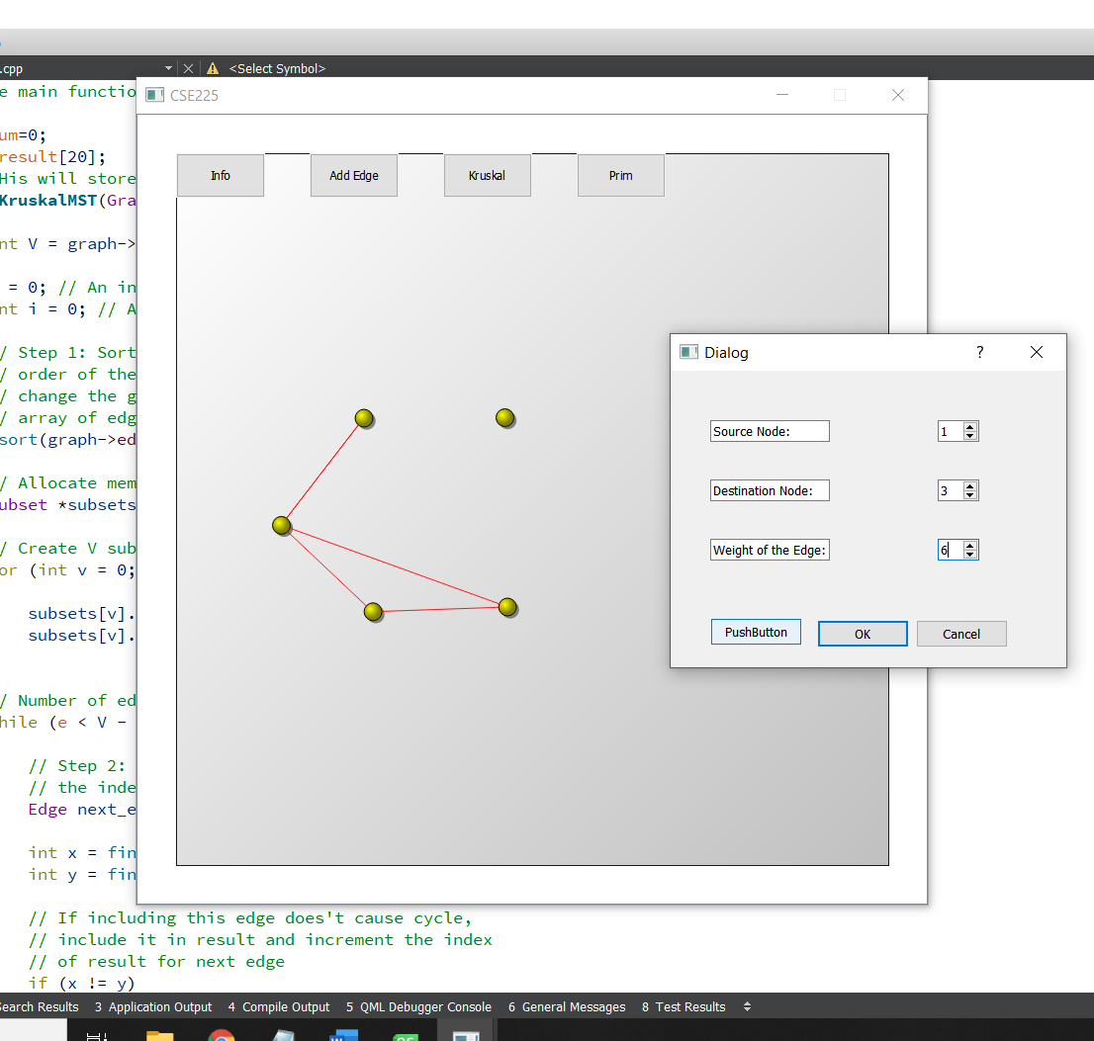
Edge between 1 and 3 of weight 6 is inserted

Slide 36
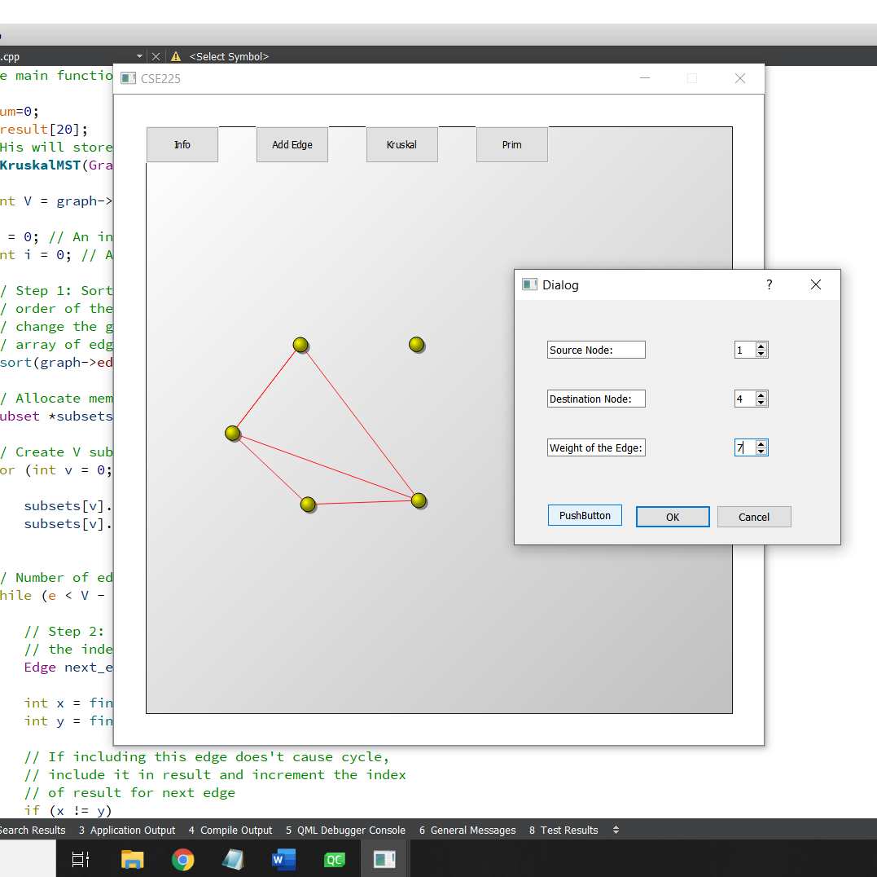
Edge between 1 and 4, of weight 7 is added

Slide 37
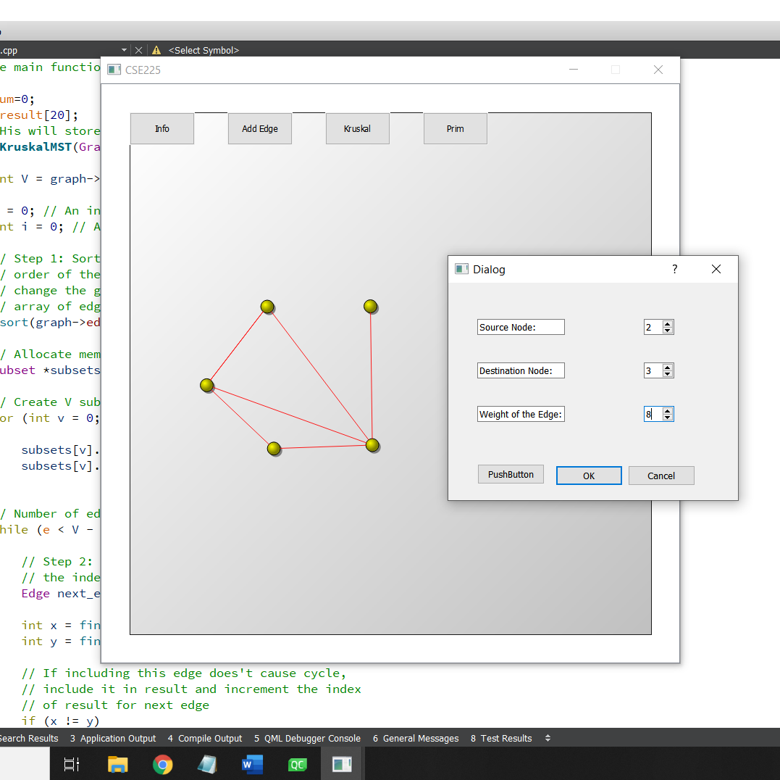
Edge between 2 and 3 of weight 8 is inserted

Slide 38
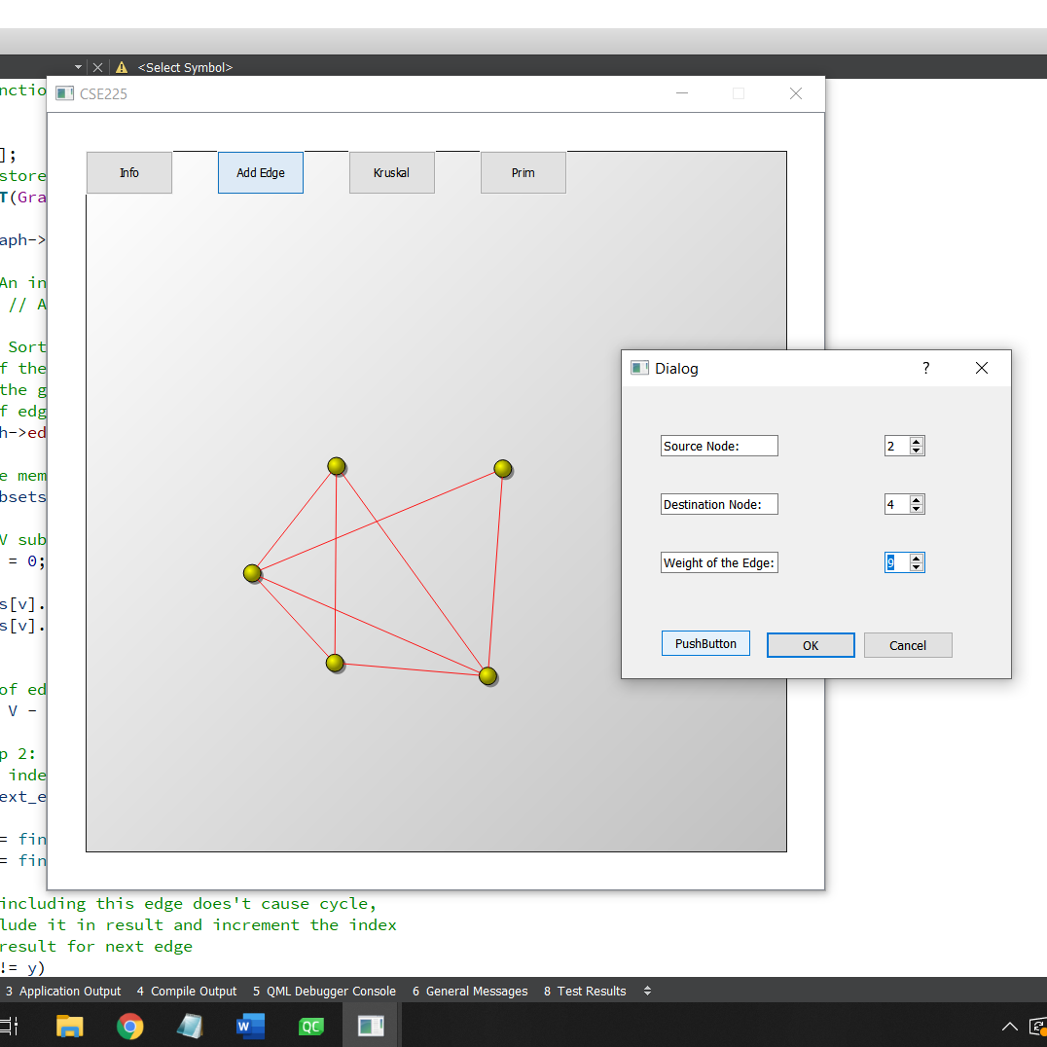
Edge between 2 and 4 is created

Slide 39
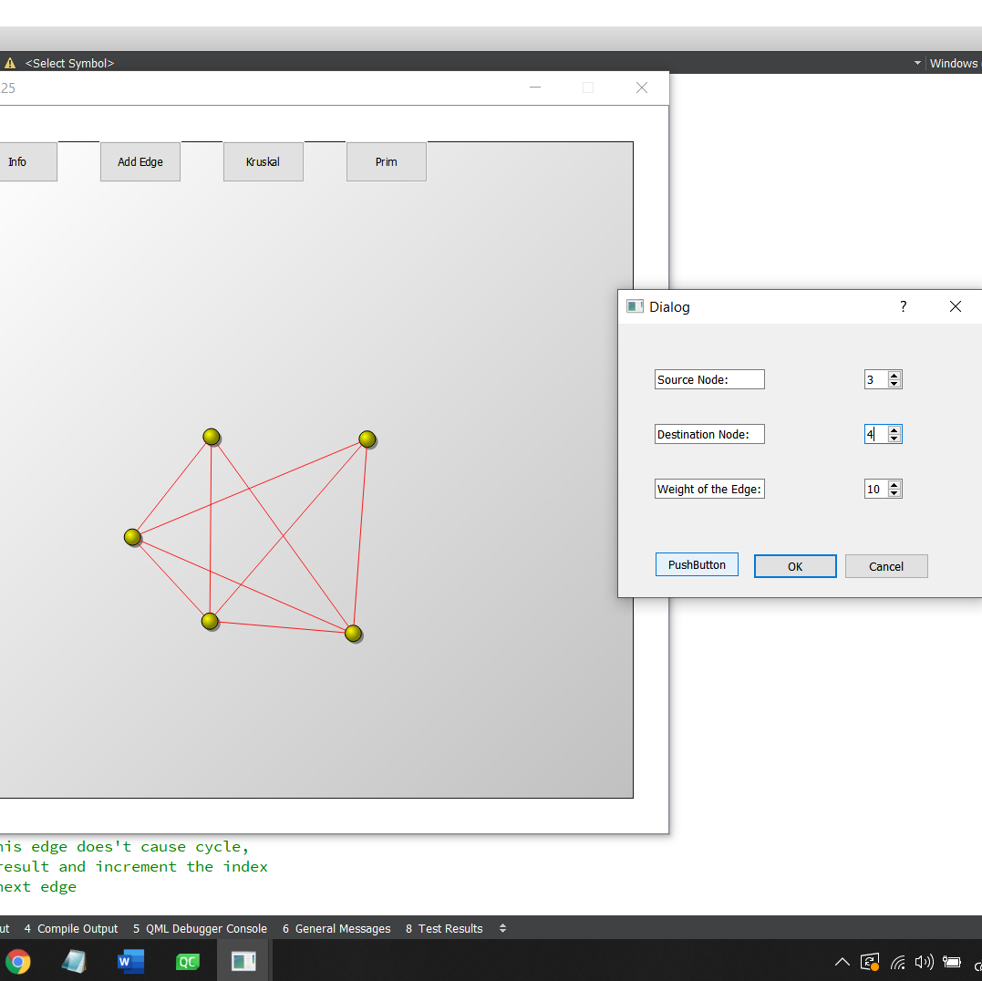
Finally, the last edge!
We insert the edge between 3 and 4, of weight 10

Slide 40
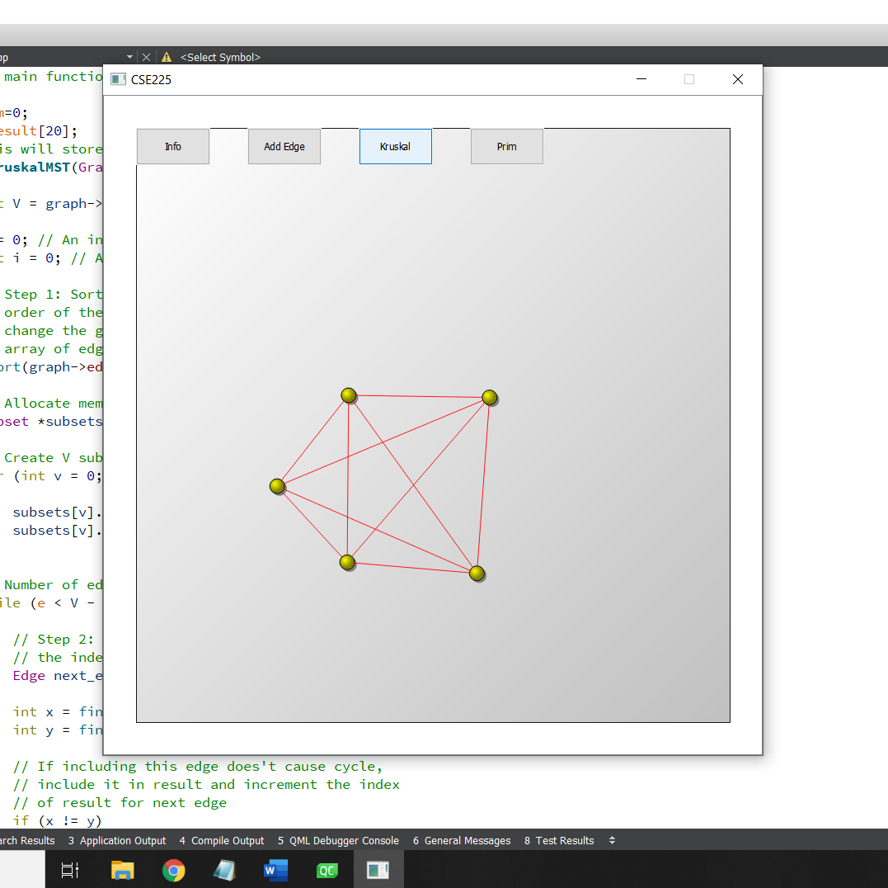
Our graph is now complete.
We click the button Kruskal

Slide 41
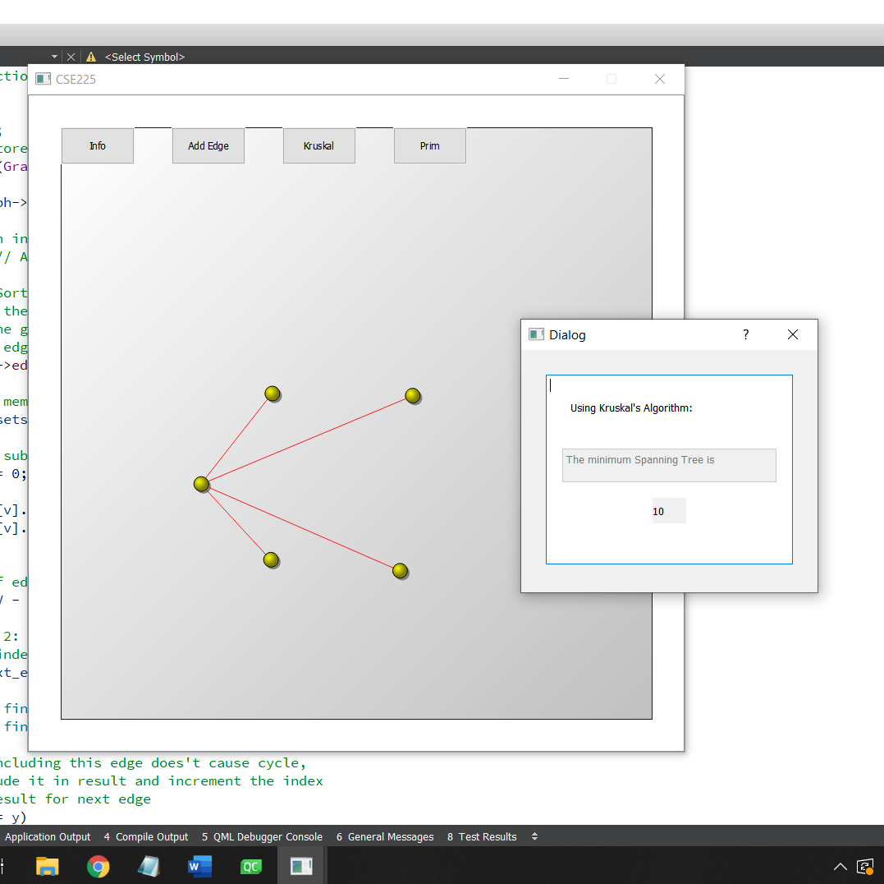
The next pop up gives the total weight of the minimum spanning tree.
Also it has given us the MST graph.
The MST obtained from the QT implementation matched the MST we implemented.

